Slide 1
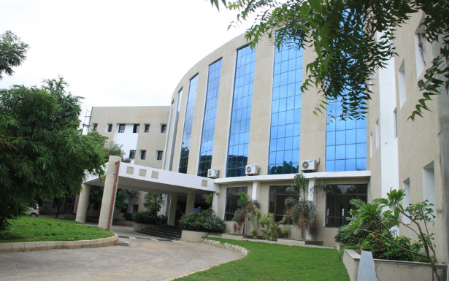
MALWARE ANALYSIS AND PREDICTION
Presented by
1.BARGAV (18QM1A0406)
2.SANDHYA (18QM1A0407)
3.BRUNDAVAN (18QM1A0417)
4.C.SAI NITIN (18QM1A0421)
Under the Guidance of
Faculty Name : DR.D.
CHANDRA PRAKASH
Designation : ASSOCIATE PROFESSOR

Slide 2
Contents
AIM
04
PROBLEM IDENTIFIFED
01
OBJECTIVE
05
MEDTHODOLOY
02
LITERATURE
DESIGN AND DESCRIPTION
03
06

Slide 3
Objective
Malware detection using AI and ML is one of the best methodology. The Technologies help in such a way that it predicts the malware based URL from stopping them to be executed in the browser. Using basic binary classifier, we will be differentiating the difference between the safe and malware URL’s

Slide 4
Literature Study
S.NO | TITLE OF THE PAPER | AUTHORS | CONFERENCE/ JOURNAL NAME | YEAR | PROBLEM ADDRESS
1. | Ensemble model for data – driven prediction of malware infections. | VS Subrahmanian, Edoardo Serra | ACM | 2016 | prediction the number of malware infections in a country
2. | Risk predicition of malware victimization based on user behavior | Anil Somayaji, Jose M. Ferendez | IEEE | 2014 | Understanding what types of users and usage are more conducive to malware infections
3. | Deep android malware detection. | NMC Laughlin | IEEE | 2017 | Automatically learned by op code.
4. | Survey of malware detection | Vinod.P | IEEE | 2009 | Examines us malware detection

Slide 5
PROBLEMS IDENTIFIED
SITE ADS GETTING DISAPPROVED DUE TO MALICIOUS LINKS
MALWARE AND UNWANTED SOFTWARE & ADVERTISING POLICIES
FALSE REPRESENTATION OF EXPECTED CONTENT
PROBLEM 1
PROBLEM 2
PROBLEM 3

Slide 6
CASE STUDIES
PREPARING OF DATA SETS
DATA VISUALIZATION TEXT DATA
MALICIOUS LINK DETECTION
PROCESSING OF DATA SET AND CLASSIFYING THE TEXT DATA
PREDICTION

Slide 7
SOFTWARE REQUIREMENTS
PYTHON LIBRARIES:
NUMPY IS CONSIDERED AS ONE OF THE MOST POPULAR AND VERY INTERACTIVE AND EASY TO USE
KERAS IS A COMPLETELY PYTHON BASED FRAMEWORK WHICH MAKES IT EASY TO DEBUG AND EXPLORE
SK learn in another python library which helps to the high level predictive algorithms in a simple code for users
PANDAS IS A MACHINE LEARNING LIBRARY WHICH PROVIDES HIGH LEVEL DATA STRUCTURES AND VARIETY OF TOOLS FOR ANALYSIS

Slide 8
MACHINE LEARNING:
ML using the best algorithms using SK learn library which makes the accuracy in the better way
Makes classification simple and understandable
It helps to view the formation and the development of one browser to handle multiple kinds of URL’s
It can directly be integrated to websites or the browser using simple python libraries

Slide 9
CONCLUSION
PREDICTION METHOD:
DECISION TREE
IT USES MULTIPLE ALGORITHM TO SPLIT NODE INTO TWO OR MORE SUB NODES
LINEAR REGRESSION
THIS PREDICT THE OUTCOME OF FUTURE EVENTS
RANDOM FOREST
TO OVERCOME THE LIMITATIONS OF DECISION TREES.

Slide 10
FUTURE SCOPE
COUNTRIES WHERE IT’S BEING IMPLEMENTED
10%
In the year 1995 Malware detection has been stated implementing
70%
By the year 2020 most of the method and alogrothim are designed to predict the malware URL

Slide 11
THANK YOU

